Slide 1

Applied Data Science – Portfolio
2019-2021
Sai Praharsha Devalla
235239596
sdevalla@syr.edu
https://github.com/saipraharsha/Portfolio

Slide 2
About me
Sai Praharsha Devalla
Undergraduate Degree: B.E in Electronics and Telecommunication Engineering ’17, KL University.
Job: Worked as Software Engineer at Infosys for 2 years from 2017 to 2019.
Masters Degree: M.S in Applied Data Science ‘21, School of Information Studies at Syracuse University.
Learning Outcome: Applying data science practices and principles to solve real-life business and scientific problems.

Slide 3
Objectives
This presentation is a modest attempt to outline the learning outcomes with which the Applied Data Science program is designed and how I have achieved it through the courses and project work that I have done.
I’ll briefly describe each learning outcomes and give examples of works which I have done to demonstrate that learning outcome

Slide 4
Describe a broad overview of the major practice areas of data science
Data Mining – IST 707, IST 687
Machine Learning – IST 718, IST 707, IST 687
Big Data and Distributed Computing – IST 718
Statistical Methods – MBC 638
Business Intelligence – IST 722, SCM 651
Data Warehousing – IST 722
Deep Learning – IST 718, CIS 731
Data Visualization – IST 687, IST 707, MBC 638

Slide 5
Collect, Clean and organize data.
Data Scientists spend 80% of time in collecting, cleaning and organizing data
For most of the projects we collected the dataset from Kaggle and imported it into R or Python (pandas).
Example Project: Airline Customer Churn Analysis (IST 687)
We were given the 4 csv files (each for one month) which had 32 variables
We imported the csv file into R and cleaned the data such that we have only 20 variables which we thought is the most important.
Once the data is set up, we decided to omit all the observations in which there is no data (”NAs”) as replacing it with mean would mislead the analysis

Slide 6
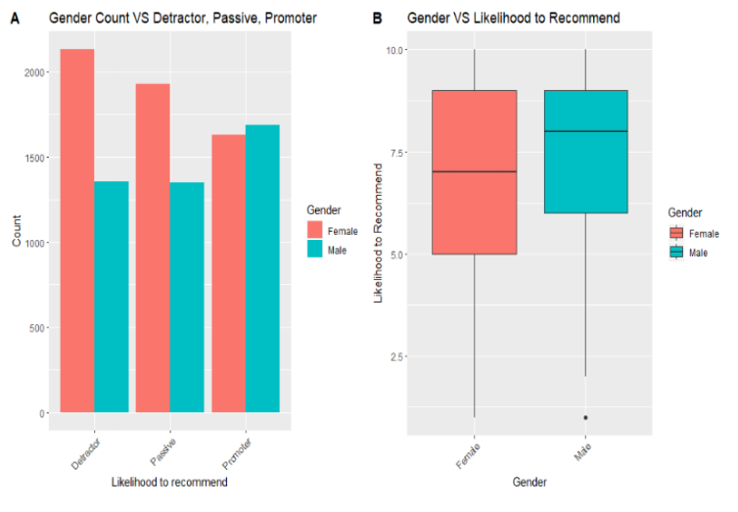
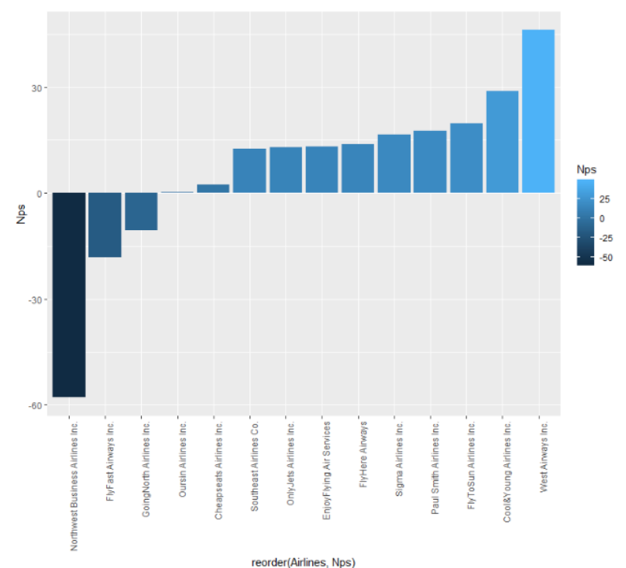
Identify patterns in data via visualization, statistical analysis, and data mining
As a Data Scientist, we need to be able to find patterns from the data that we are analyzing and support decision making.
Example Project: Airline Customer Churn Analysis (IST – 687)

Slide 7
Develop alternative strategies based on the data.
Based on the business questions that we are trying to solve and the type of data that we are involved with, we need to determines the approach that we must take.
In Artificial neural networks (CIS 731), we dealt with times series data. Hence, we used techniques like using preceding ‘N’ outputs.
In Big Data Analytics (IST 718) we learnt the concept of Principal Component Analysis which is used for dimensionality reduction.

Slide 8
Develop a plan of action to implement the business decisions derived from the analyses.
The main idea behind analyzing data is to get insights and make recommendation to the business to make informed decisions.
Example Project: Airline Customer Churn Analysis (IST 687)
Our recommendation to Airlines to improve its NPS score were:
So, the airlines in “Blue” status should attract the customers with some discount coupons and improving their services.
Airlines should focus on giving better amenities such as wheelchair services, better seats, assistance at the time of check-in and express boarding to customers who are above 54 years as they are more likely to be detractors.
Airlines who have passengers travelling for business purposes should focus that the flight is running on time as if the flight is delayed there is a high probability that they might give a negative rating

Slide 9
Demonstrate communication skills regarding data and its analysis for managers
Communicating the findings to the managers and stakeholders is an important quality that a Data Scientist should posses.
Every project that I did in the program had a presentation in which we would brief our projects to the entire class.
Data Analytics (IST 707) had poster presentations. This helped us to learn how to explain our findings to a non-technical people as well

Slide 10
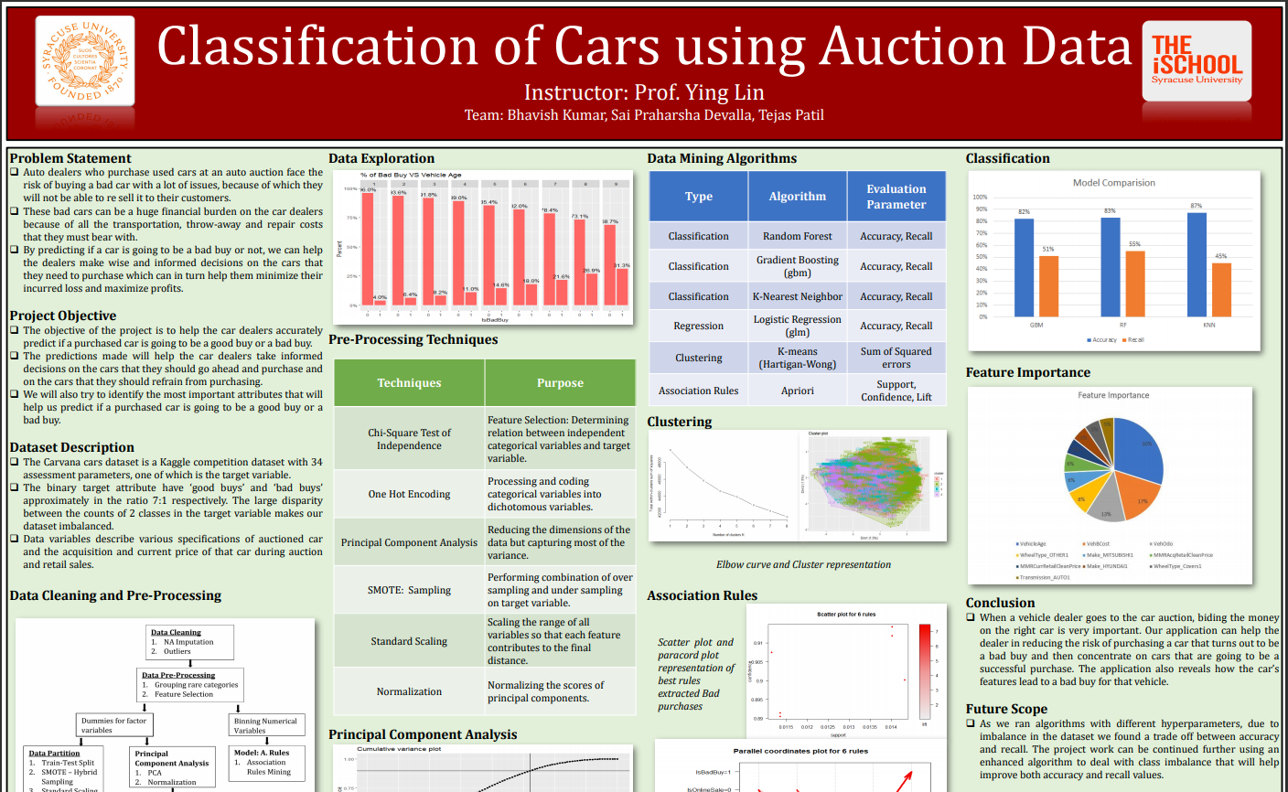

Slide 11
Synthesize the ethical dimensions of data science practice
Before putting on the lab coat to analyze the data, a data scientist must be aware of what data is he dealing with, will the findings by any means harm anyone, what extent the analysis will give control to the stakeholders, etc.
In other classes, Professors had briefed us the importance of ethical dimensions while dealing with the data.

Slide 12
Next Steps
With the skills that I have gained in the program, I would like to contribute to the society keeping in the mind the ethical dimensions
I’m actively interviewing for Data Engineer positions.
I hope to expand my data science knowledge into the fields which have not been explored in this program such as cloud computing (AWS, Azure)

Slide 13

Thankyou

